Slide 1
Chapter - Two
Object Orientation: The new software paradigm

Slide 2
Object Technology
Object-Oriented (OO) paradigm/standard is a development strategy based on the concept that systems should be built from a collection of reusable parts called objects.
In a system development using this paradigm: you need
Interface objects to enable your users to work with your system
Process objects that implement logic that works with several business concepts
System objects that provide technical features such as security and messaging.

Slide 3
Benefits of object orientation
Reduced Maintenance: the system will have longer life and less maintenance cost because most of the processes within the system are encapsulated and behaviors are reused
Real-World Modeling: tends to model the real world in a more complete fashion than do traditional methods. The model is based on objects, rather than on data and processing.

Slide 4
Cont…
Improved Reliability and Flexibility: more reliable than traditional systems, primarily because new behaviors can be "built" from existing objects. The new objects may inherit data attributes or behaviors from one, or many other objects.
High Code Reusability: inheritance allows code reusability

Slide 5
In general object orientation has the following advantages:
Simplicity: software objects model real world objects, so the complexity is reduced and the program structure is very clear;
Modularity: each object forms a separate entity
Modifiability: it is easy to make minor changes in the data representation or the procedures. Changes inside a class do not affect any other part of a program
Extensibility: adding new features or responding to changing operating environments can be solved by introducing a few new objects and modifying some existing ones
Maintainability: objects can be maintained separately, making locating and fixing problems easier
Re-usability: objects can be reused in different programs.

Slide 6
Drawbacks of Object orientation
Lack of understanding and unrealistic expectations are causes for abuse and misuse of new technologies.
There are different drawback/pitfalls. Let see them one by one

Slide 7
Conceptual Pitfalls:
confusion about what OOSAD is and what it requires: Managers and developers
Adopting new technology has impact
Assume that using OOSAD will eliminate various development bottlenecks, reduce the management of complexity and provide architectural modularity. But this may work best with different management and scheduling techniques.

Slide 8
Cont…
3. Neglecting software engineering process(SDLC)
4.Developers lack enough knowledge and education about OOSAD
In all four of the above areas, time spent at the beginning will save time later. But top managements do not understand this they would rather like to have the product ready in the least amount of time and cost.
Education and experience are keys for the success of any OOSAD project.

Slide 9
Analysis and Design Pitfalls :
Come from the struggle to manage complexity using OO technology
Two possible situations are related to this drawback are:
developers may take a SDLC approach to analysis and design and then attempt to implement it using object-oriented techniques
developers may attempt to use an OOSAD approach, but then create classes with their hierarchies and connections which is more along the lines of traditional programs

Slide 10
Cont…
In both cases, there may be confusion about the relationship between object classes. This leads to
poor solutions to the problems,
loss of benefits of OOSAD, and
lack of expectation with OOSAD
Thus, before developers start a project, they must decide whether to use OOSAD, have a good reason to adopt OOSAD and have a good understanding of the risks involved.

Slide 11
Environment, Language and Tool Pitfalls:
Environment comprises the operating systems and application environments in which a given project will run.
Languages include the various object-oriented languages used to implement object design: Smalltalk, C++, Java, and others.
Tools are what developers use to create and test the application: editors, compilers, browsers, source code management systems etc.

Slide 12
Selection of the wrong environment, language, or tool outbreak the OOSAD project with constant problems or bugs in the development and even deployment of applications.
To prevent this pitfall,
developers should consider technology, compatibility and economic issues before selection of environment, languages and tools.
developers should validate their selection of tools and languages early by trying out the complete set of tools

Slide 13
Implementation Pitfalls :
come from neglecting other software engineering activities such as
comprehensive analysis, design, development scheduling and deliverables, and
proper planning for system testing and installation/conversion.
To prevent growth of this problem:
analysis and design be sufficiently completed.
define design, implementation, documentation and coding standards for each subsystem and class before coding and implementation take place.

Slide 14
Class and Object Pitfalls :
Confusion of is-a, has-a, and is-implemented-using relationships
Confusion of interface and inheritance during implementation
Use of inheritance to violate encapsulation
Use of multiple inheritance (MI) to invert the is-a relationship; and
Use of Multiple inheritances in any circumstances.

Slide 15
The above miss use of inheritances leads to
poor hierarchy and class design,
unpredictable behavior of objects,
unnecessary complexity in the project,
loss of OOD benefits,
low rate of code reuse and product instability
To avoid these pitfalls,
developers should set guidelines to create class hierarchies.
For each class to be defined, use the descriptions to determine the relationships with existing classes.
Set up the interface and implementation inheritance according to the class design.
Set guidelines for how methods should be exported and inherited or overridden

Slide 16
Reuse Pitfalls:
One of the primary goals of OOSAD has been reuse of code. However, the explicit goal of reuse is harder and takes longer because reuse takes time and effort up front, whereas OOSAD is promoted and adopted as a means to get software developed more quickly.

Slide 17
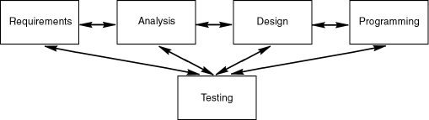
The object orientation software process
In this approach, a system is defined as a collection of objects not as two separate parts(data and function). Because objects do things(i.e. have functionality) & objects know things(i.e. have data)
A minimal software process(major OOSD activities)

Slide 18
software development is serial on the large scale and iterative on the small scale, delivering incremental releases over time
Object-oriented requirements gathering
Purpose: to understand what the system should do
Is the first step of any software development effort.
you may not gather all of your requirements at once, but you should at least start with a few
Problems at this stage:
many people do not want to invest the time to elicit requirements; instead, they want to jump right into programming
Solution: convince all project stakeholders that this preliminary work is critical to the success of the project

Slide 19
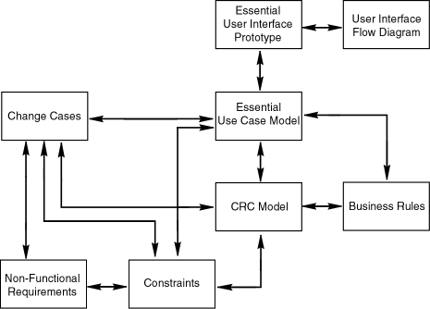
Overview of requirements artifacts and their relationships

Slide 20
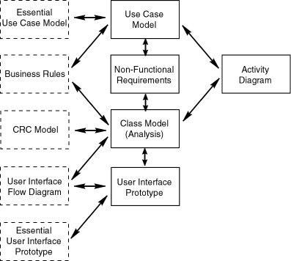
Object-oriented analysis
Purpose: is to understand what will be built.
It is similar with requirement gathering, their difference is:
requirements gathering: is on understanding your users and their potential use of the system
analysis :to understanding the system itself
Overview of analysis artifacts and their relationships

Slide 21
Cont…
important implications of the above figure
analysis is an iterative process
requirements gathering and analysis are highly interrelated and iterative
your essential use case model, essential user interface prototype and CRC model evolve into corresponding analysis artifacts
In this figure every possible "drives" relationship is not shown. But that does not mean there is no r/ship between the artifacts. For example: as you are developing use case model you will realize that you are missing a feature in your user interface. At this time:

Slide 22
Cont…
consider what the problem is, update your use case model appropriately, propagate the change to your essential use case model, then to your essential user interface model, then, finally, into your user interface model
Or update both your use case model and user interface model together and then propagate the changes to the corresponding requirements artifacts
This is an important aspect of iterative development -- you do not necessarily work in a defined order

Slide 23
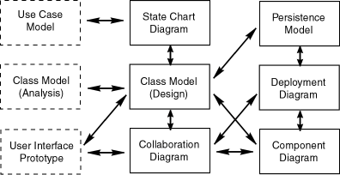
Object-oriented design
Purpose: is to determine how you are going to build your system -- information needed to drive the actual implementation of your system
Overview of design artifacts and their relationships

Slide 24
important implications of the above figure
design is an iterative process
analysis and design are highly interrelated and iterative
your analysis class model evolves into your design class model to reflect features of your implementation environment, design concepts
At the beginning of the design process you must decide on:
to take a pure, object-oriented approach to design or a component-based approach?
OO approach: your software is built from a collection of classes
Component based approach: your software is built from a collection of components(other components(non-object technologies), classes)

Slide 25
follow all or just a portion of a common business architecture.
take advantage of all or a portion of a common technical infrastructure (Enterprise JavaBeans, CORBA framework etc)
which non-functional requirements and constraints your system will support (Access Rights & sharing approaches)

Slide 26
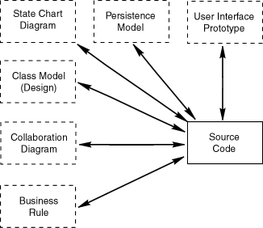
Object-oriented programming
Purpose: is to build your actual system -- to develop the code that fulfills your system's design.
Design artifacts drive development of source code

Slide 27
important implications of the above figure
design and programming are highly interrelated and iterative
Your programming efforts will immediately reveal weaknesses in your design that will have to be addressed
focus on two types of source code:
object-oriented code such as Java code or C++, and
persistence mechanism code such as data definition language (DDL), data manipulation language (DML), stored procedures, and triggers.

Slide 28
Your class models, state chart diagrams, user interface prototypes, business rules, and collaboration diagrams drive the development of your object-oriented code
your persistence model drives the development of your persistence code.

Slide 29
Object-oriented testing
Purpose: identifying and fixing problems
A fundamental rule of SE: is that you should test as early as possible. It is available in all stages.
Most mistakes are made early in the life of a project and the cost of fixing defects increases exponentially the later they are found.
Technical people are very good at things like design and coding but are often not as good at non-technical tasks such as gathering requirements and performing analysis
Developers have a tendency to make more errors during requirements definition and analysis than during design and coding

